Slide 1
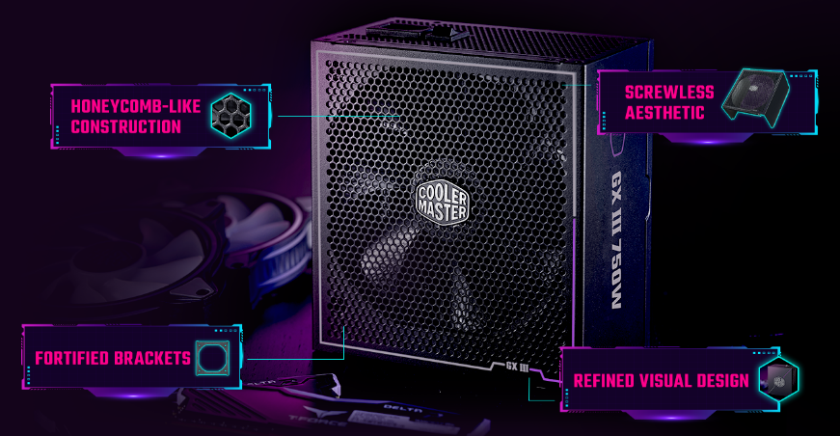
STRENGTH IN ELEGANCE
Introducing the GX III Gold, featuring an all-new material and structural design with hexagonal details for improved airflow and a cleaner overall look. This 80 Plus Gold and Cybenetics Platinum certified unit can achieve Titanium level efficiency at light loads in a 115V test.
The GX III Gold also features ATX 3.0 support, a durable 12VHPWR cable, a half-bridge APFC, LLC, and DC-DC design, anodic-coated heat sinks that reduce average component temperature by 5 °C, and an STCM zero-RPM fan. The GX III Gold achieves excellent performance, efficiency, noise reduction, and heat dissipation.
GX III Gold 750
Exceptional efficiency: This 80 Plus Gold and Cybenetics Platinum certified unit can achieve Titanium level efficiency at light loads in a 115V test.
Optimized thermal performance: An anodic-coated heat sink keeps average component temperatures 5℃ lower than a traditional heat sink for enhanced durability and a prolonged life span.
ATX 3.0 support & a durable 12VHPWR cable: Includes ATX 3.0 support and a 90-degree 12+4pin (12VHPWR) PCIe 5.0 cable featuring lower temperatures, enhanced durability, and improved safety.
Silent fan performance with a zero-RPM mode: This unit includes a smart thermal control mode that defaults to zero spin.
High-quality Japanese capacitors: High-quality Japanese capacitors feature reduced ripple noise and enhanced reliability.
Fully modular cabling: Efficiently reduces clutter, increases airflow, and improves overall efficiency and thermal performance.
Innovative, streamlined design: An innovative screwless aesthetic provides a cleaner appearance, and the hexagonal fan cover improves air intake efficiency.
10-year warranty: This unit comes with a standard limited manufacturing warranty of 10 years from the date of purchase.

Slide 2
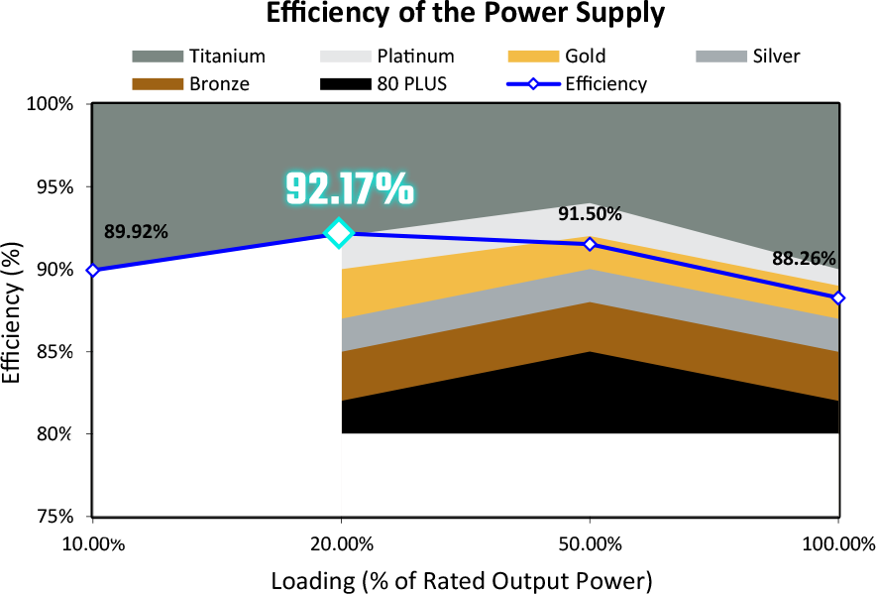
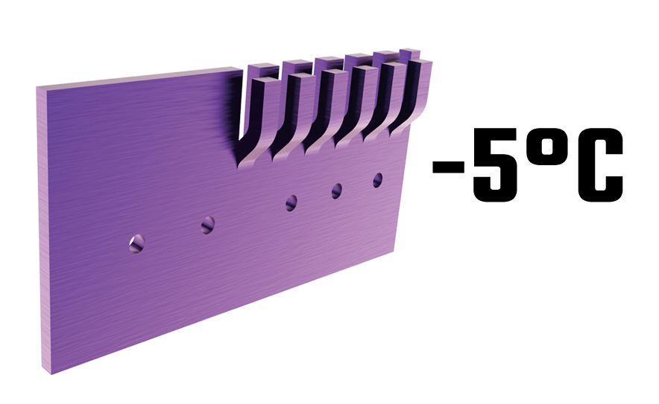
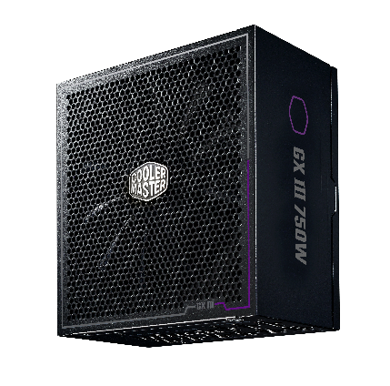
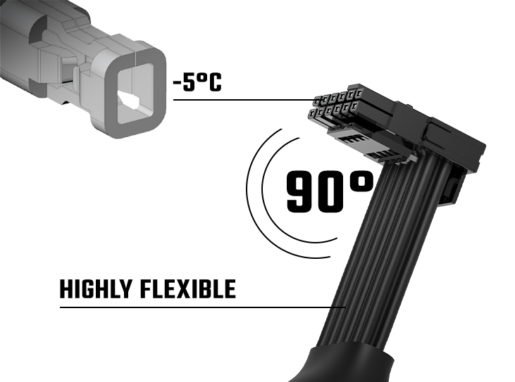
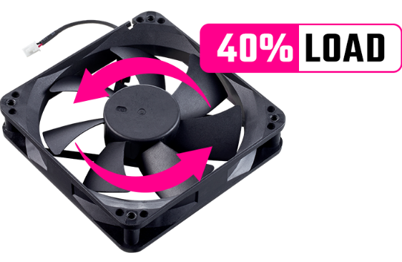
Exceptional efficiency
Optimized thermal performance
Can achieve 80 Plus Titanium level efficiency during general use.
An anodic-coated heat sink keeps average components temperatures 5℃ lower.
Dual efficiency certification
Streamlined, screwless aesthetic
80 Plus Gold and Cybenetics Platinum certified.
Innovative screwless aesthetic and sleek design.
Silent and smart performance​
A durable 12VHPWR cable
Zero-RPM default mode below 40% loads.​
An advanced thermal structure and flexible cable provide improved safety.

Slide 3
Product Name​ |  | GX III Gold 750
Item Code​ |  | MPX-7503-AFAG
ATX Version​ |  | ATX 12V Ver. 3.0​
PFC​ |  | Active PFC​
Input Voltage​ |  | 100 - 240V​
Input Current​ |  | 10 - 5A​
Input Frequency​ |  | 50 - 60Hz​
Dimensions (L x W x H)​ |  | 160 x 150 x 86mm​
Fan Size​ |  | 135 mm​
Fan Bearing​ |  | HDB​
Fan Speed |  | 1900rpm
Efficiency​ |  | ≥ 90% @ Typical Load​
80 PLUS Rating​ |  | 80 PLUS Gold​
ErP 2014 Lot 3​ |  | Yes​
Operating Temperature​ |  | 0 ~ 50℃​
Power Good Signal​ |  | 100 - 150 ms​
Hold Up Time​ |  | ≥ 16ms
MTBF​ |  | >100,000 hours​
Protections​ |  | OPP / OVP / OTP / OCP/ SCP / UVP / Surge & Inrush Protection​
Regulatory​ |  | cTUVus, TUV, CE, FCC, BSMI, CCC, EAC, RCM, UKCA, RoHS2.0 / BIS, KC (based on region's request.)
Connectors | ATX 24 Pin​ | x1 = 1x (610mm)​
 | EPS 4+4 Pin​ | x1 = 1x (600mm)​
 | EPS 8 Pin​ | x1 = 1x (600mm)​
 | SATA​ | x8 = 2x (500+120+120+120mm)​
 | Peripheral 4 Pin​ | x4 = 1x (500+120+120+120mm)​
 | PCI-e 6+2 Pin​ | x3 = 3x (550mm)​
 | 12VHPWR​ | x1 = 1x (650mm)​
AC INPUT | 100-240V~ 10 - 5A 50 - 60Hz
DC OUTPUT | +3.3V | +5V | +12V | -12V | +5Vstb
 | 20A | 20A | 62.5A | 0.3A | 3A
TOTAL POWER | 120W |  | 750W | 3.6W | 15W
 | 750W

Slide 4
Cable Type | EAN | UPC
MPX-7503-AFAG-BUS | 4719512136041 | 884102108365
MPX-7503-AFAG-BUK | 4719512136058 | 884102108372
MPX-7503-AFAG-BEU | 4719512136065 | 884102108389
MPX-7503-AFAG-BST | 4719512136072 | 884102108396
MPX-7503-AFAG-BAU | 4719512136089 | 884102108402
MPX-7503-AFAG-BBR | 4719512136096 | 884102108419
MPX-7503-AFAG-BKR | 4719512136102 | 884102108426
MPX-7503-AFAG-BTW | 4719512136119 | 884102108433
MPX-7503-AFAG-BJP | 4719512136126 | 884102108440
MPX-7503-AFAG-BIN | 4719512136133 | 884102108457
MPX-7503-AFAG-BWO | 4719512136140 | 884102108464
Net Weight | 2.582 kg / 5.692 lb
Gross Weight | 2.972 kg / 6.552 lb
Package Dimensions | 320 x 195 x 125mm (12.59 x 7.68 x 4.92")
Carton Dimensions | 520 x 335 x 231mm (20.47 x 13.18 x 9.09")
Unit / Carton | 4 pcs
Carton / Pallet | 24 pcs
All images and descriptions are solely for example purposes.
Specifications, features, and prices are subject to change without notice.
Specifications, appearances, and features may vary by model and region. Please refer to official specification pages for full details.
Unless otherwise stated, all performance claims are based on theoretical performance. Actual figures may vary in real-world situations.
Any configuration other than original product configuration is not performance guaranteed.

